Slide 1
Home Owl
Autonomous Security Robot
Samantha Buckle
Dylan Dauz
Sameeh Olipani
Sheldon Peters

Slide 2
Project Recap
This project aims to design and build a robot for use in the monitoring of indoor spaces
Robot will be capable of:
Autonomous movement
Navigation of a building or room without the need for human control
Utilize sensors to detect loud noises or the presence of a person
Flash lights and play an alarm sound when disturbance is detected
Get signal from remote control to turn the system on and off

Slide 3
Research Outline
4 Major areas of research
Motors
What type motors we will use
Also what kind of wheels we will be using
Core Electronics
The main processor of the robot
Sensors
What sensors we will be using for navigation and detection
Navigation Algorithm
How the robot will navigate its environment
Later research will include
Alert System
Flashing lights and alarm sounds
Remote Signaling
On/off for the robot
On/off for the alarm

Slide 4
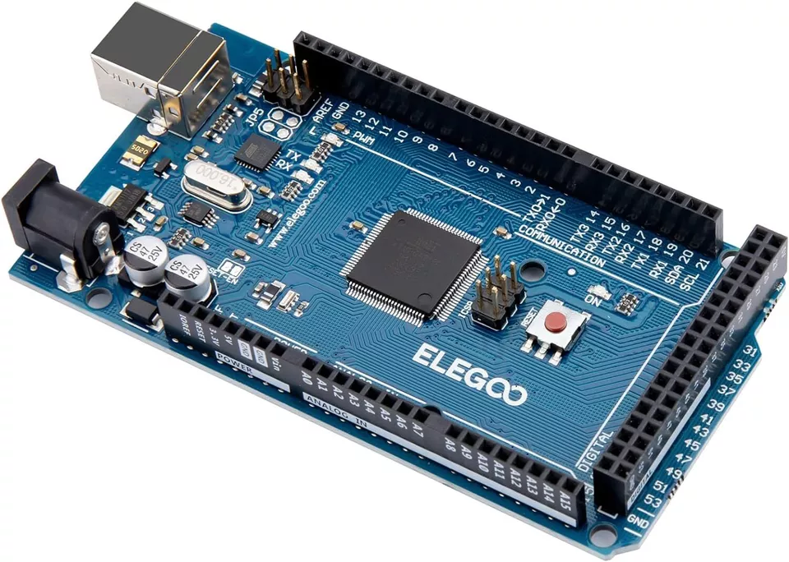
Core Electronics
Usage of microcontroller
Brain of components
Controllering motors
Interfacing sensors
Elegoo Mega 2560 R3
Arduino Mega vs Elegoo Mega
Ultimate Starter Kit for Elegoo
Servo motors and stepper motors
IR receiver and PIR sensor
Ultrasonic sensors
Power module

Slide 5
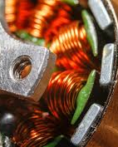
Motors
Motors
BLDC motors use an electronic controller to manage the current flow through the stator, creating a rotating magnetic field that turns the rotor, which results in very quiet operation.
Paired with a motor controller and an encoder, BLDC motors provide smooth and precise control over speed and torque.
While BLDC motors can run at higher speeds than brushed motors, speed isn't our priority since we are focused on patrolling steadily, which also helps maintain quiet operation.

Slide 6
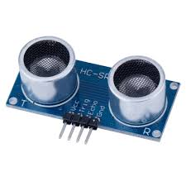
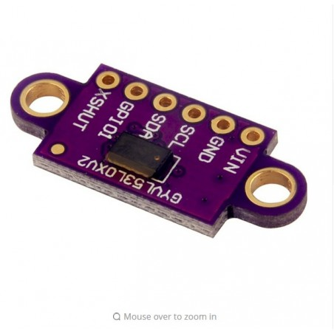
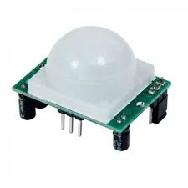
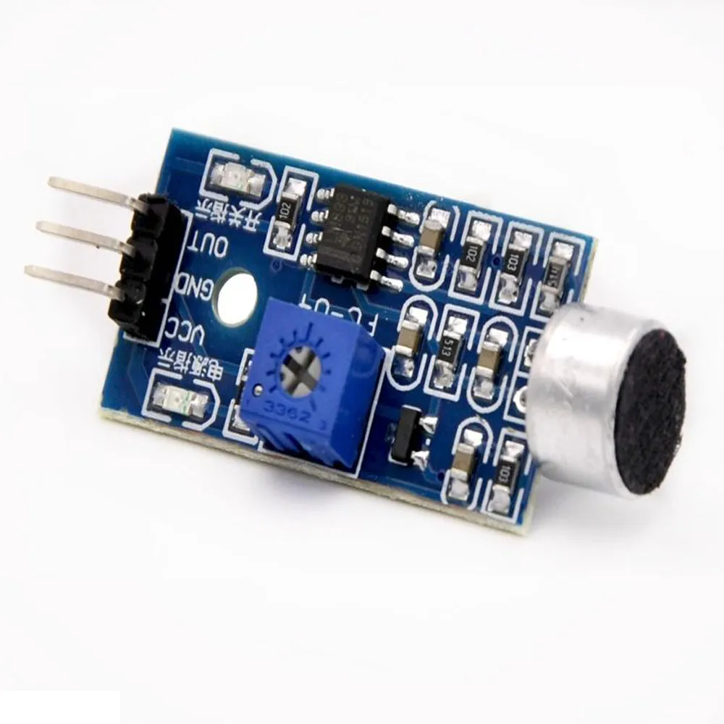
Sensors
Navigation Sensors
Ultrasonic Sensors
Detects distance away from an object using ultrasonic sound
Can’t be used while other ultrasonic sensors are running
Time of Flight Sensors
Detects distance away from an object using IR photons
Can be used while other ToF sensors are running
Possibility of also being used to detect motion
A company uses them to count people entering an area
Detection Sensors
Passive IR Sensor
Detects motion via difference in two IR sensing slots
Sound Sensor
Will detect sounds above a set threshold
Both the ToF and PIR sensors will require our robot to stay still to detect motion, otherwise the robot’s own movement will trip the sensors.

Slide 7
Navigation Algorithm
To move around the room, the robot will use encoders to measure the distance it has traveled
Use ultrasonic sensors to make sure it doesn’t run into walls
Time the ultrasonic sensors to go off at different times so the signals don’t interfere with each other
Programming aspects
Since we are interfacing with an Arduino, we can use MATLAB or the Arduino IDE directly for programming the sensors and electronics
MATLAB libraries exist for some of the sensors

Slide 8
Next Steps
Continue to refine research on the 4 major areas
Core electronics, motors, sensors, and navigation algorithm
Round off other minor areas of research
Alert system, remote signalling, miscellaneous parts
Finalize component choice
Begin designing
Order parts by the end of the semester

